Slide 1
Git Basics
Klausurtagung 2020

Slide 2
Agenda
Session objectives
What is version control?
<objective 1>
<objective 2>
<…>
Setting up git
Create your first repository
Feature Branch Workflow

Slide 3

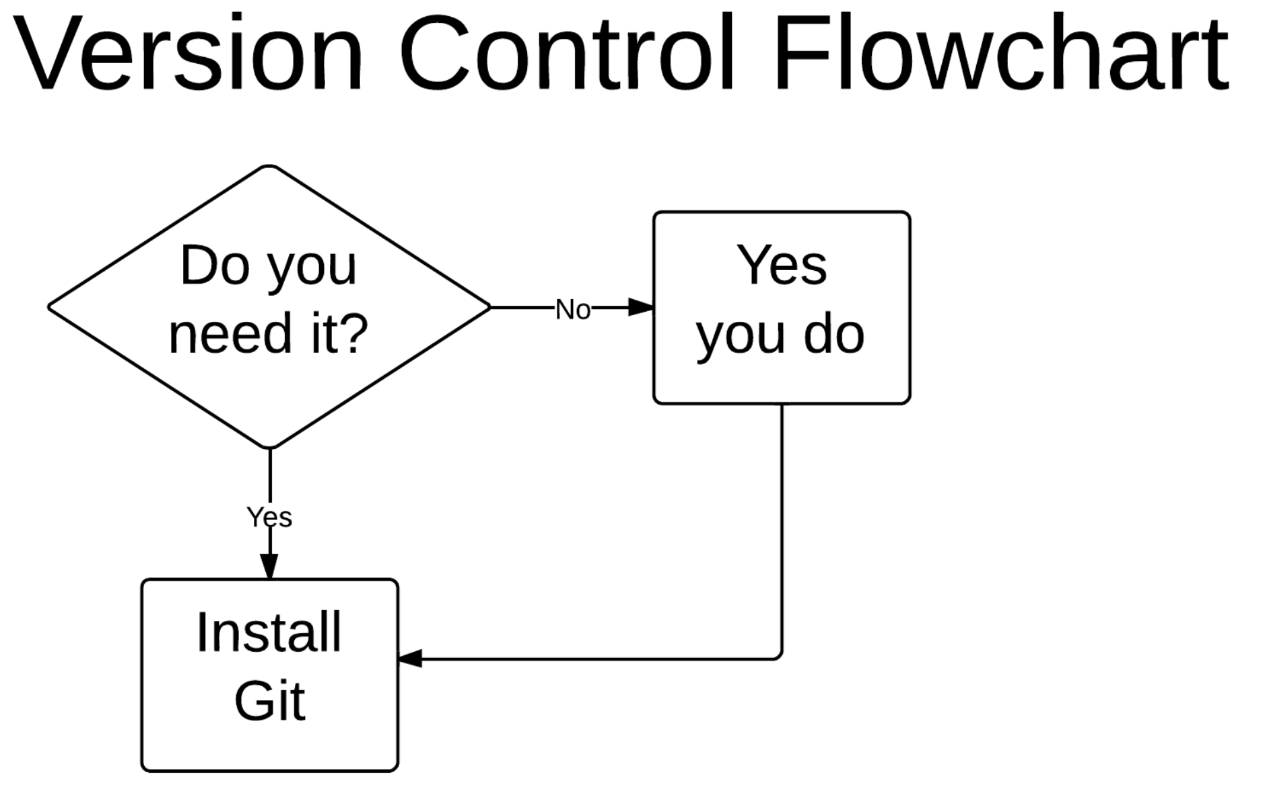
Why do we need version control?

Slide 4
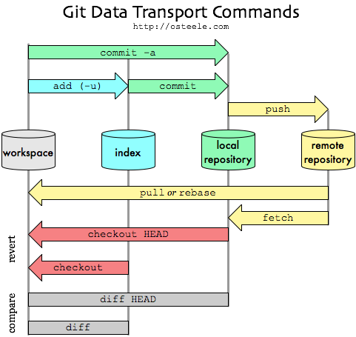
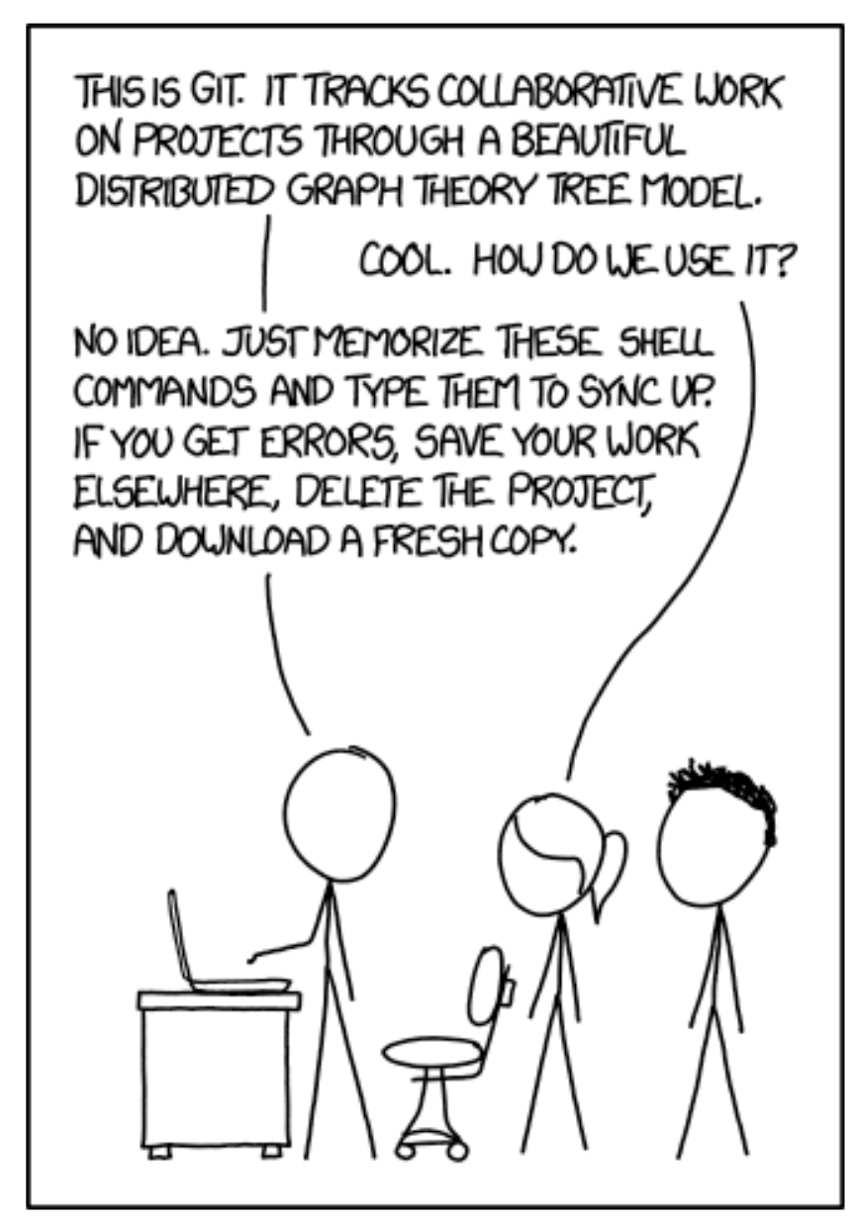
How does it work?

Slide 5
Agenda
Session objectives
What is version control?
<objective 1>
<objective 2>
<…>
Setting up git
Create your first repository
Feature Branch Workflow

Slide 6
Install git
A very good tutorial:
https://happygitwithr.com/install-git.html
Install Git for Windows:
https://gitforwindows.org
NOTE: When asked about “Adjusting your PATH environment”, make sure to select “Git from the command line and also from 3rd-party software”. Otherwise, we believe it is good to accept the defaults.
Install Git for Mac:
Go to the Terminal and and install the Xcode command line tools (which include git) by entering:
“xcode-select –install”
Or if you use Homebrew:
“brew install git”

Slide 7
Configure Git
On Windows:
Enter the Git Bash shell
On Mac and Linux:
Enter the shell
Configure your git:
git config --global user.name “Max Mustermann”
git config --global user.email “max.mustermann@mail.com”

Slide 8
Agenda
Session objectives
What is version control?
<objective 1>
<objective 2>
<…>
Setting up git
Create your first repository
Feature Branch Workflow

Slide 9
Create your first repository
Go to https://github.com/ and create an account (make sure to use the email address from your git config)
Click green “New repository” button
How to fill this in:
Repository name: myrepo (or whatever you wish, we’ll delete this soon anyway).
Description: “testing my setup” (or whatever, but some text is good for the README).
Public
YES Initialize this repository with a README

Slide 10
Clone the repo to your local computer
Go to the shell
Make a new directory and move into it
mkdir test
cd test
Clone your repository (copy the link from github.com)
git clone https://github.com/YOUR-USERNAME/YOUR-REPOSITORY.git

Slide 11
Make a local change, commit, and push
Add some text to the README with the editor of your choice
Verify that git notices the change:
git status
Stage and commit this change and push it to your remote repo on github
git add -A
git commit –m “My first commit”
git push origin master

Slide 12
Clean up
Delete the local test folder
Delete the repository on github.com

Slide 13
Agenda
Session objectives
What is version control?
<objective 1>
<objective 2>
<…>
Setting up git
Create your first repository
Feature Branch Workflow

Slide 14
The Feature Branch Workflow
The feature branch workflow is a common way of collaborating on projects
Basically, the feature branch workflow looks like this:
Clone or create a GitHub repository
Create a feature branch in which to place your changes
Make your changes to the new branch
Commit the changes to the branch
Push the branch to GitHub
Open a pull request from the new branch to the original repo
Clean up after your pull request is merged
For more details see https://www.atlassian.com/de/git/tutorials/comparing-workflows/feature-branch-workflow

Slide 15
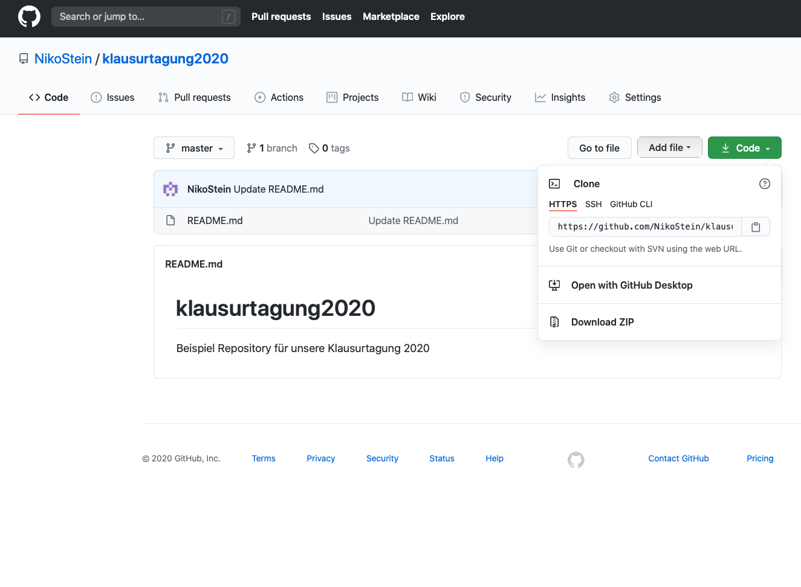
Clone the repository
First, clone our Klausurtagung2020 repository:
Go to www.github.com
Make sure you’re logged into GitHub with your account
Find the GitHub repository with which you’d like to work on (https://github.com/NikoStein/klausurtagung2020)
Clone the repository to your local machine using
git clone https://github.com/abc/abc.git

Slide 16
Work in a new feature branch
Now you are all set-up to start making changes to your local Git repository
However, you should use branches to effectively collaborate with others on the same repo
To create a new branch and check it out use:
git checkout –b <new branch name>
You can switch you active branch by
git checkout <branch name>
Finally, you can work on your code and push changes to the new branch in your forked repository by
git push origin <branch name>

Slide 17
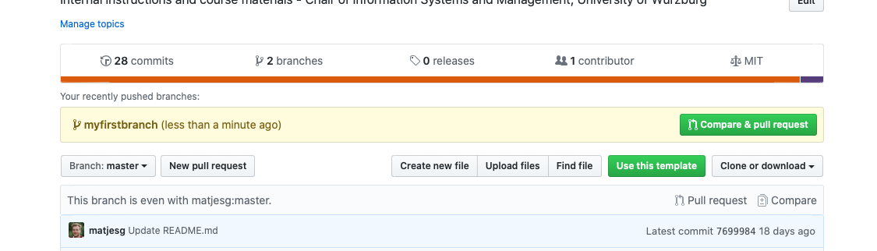
Opening a pull request
Prior to pushing your changes to the master branch you should update your feature branch
git checkout master (switch to master branch)
git fetch -p origin (update from github)
git merge origin/master (merge to local master)
git checkout <feature-branch> (switch branch)
git merge master (merge master into new)
git push origin <feature-branch> (push changes)
To submit your changes to the master you have to create a Pull Request for the feature branch on the github website

Slide 18
Cleaning up after a merged pull request
After your pull request has been accepted you can clean up the branch
Checkout the master branch
git checkout master
Update your local clone by using
git pull origin master
Delete the feature branch
git branch -D <branch name>
Delete the feature branch on your GitHub repository
git push --delete origin <branch name>

Slide 19
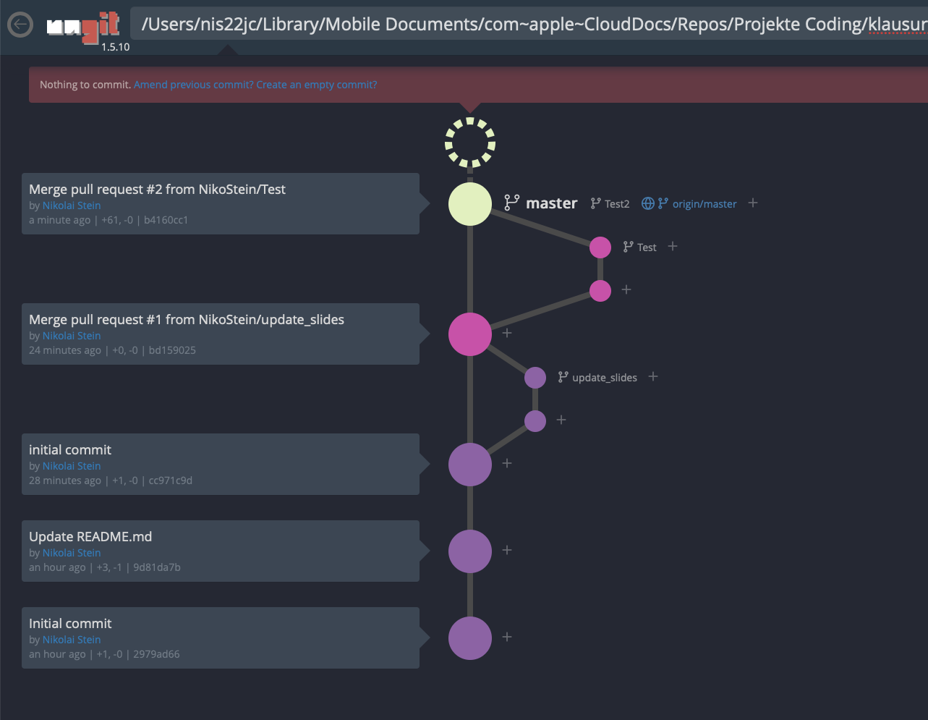
Some helpful tools if you don‘t like the command line
JupyterLab Git extension:
https://github.com/jupyterlab/jupyterlab-git
Ungit:
https://github.com/FredrikNoren/ungit
Sourcetree:
https://www.sourcetreeapp.com

